Slide 1

Azure for “Normal” People
Arrange yourselves into four co-operative working groups (3 groups of 4 learners)
In your groups, write a list of all the “Azure Words” you know
Teresa Binks
Stephen Brown
Tom Prutz

Slide 2
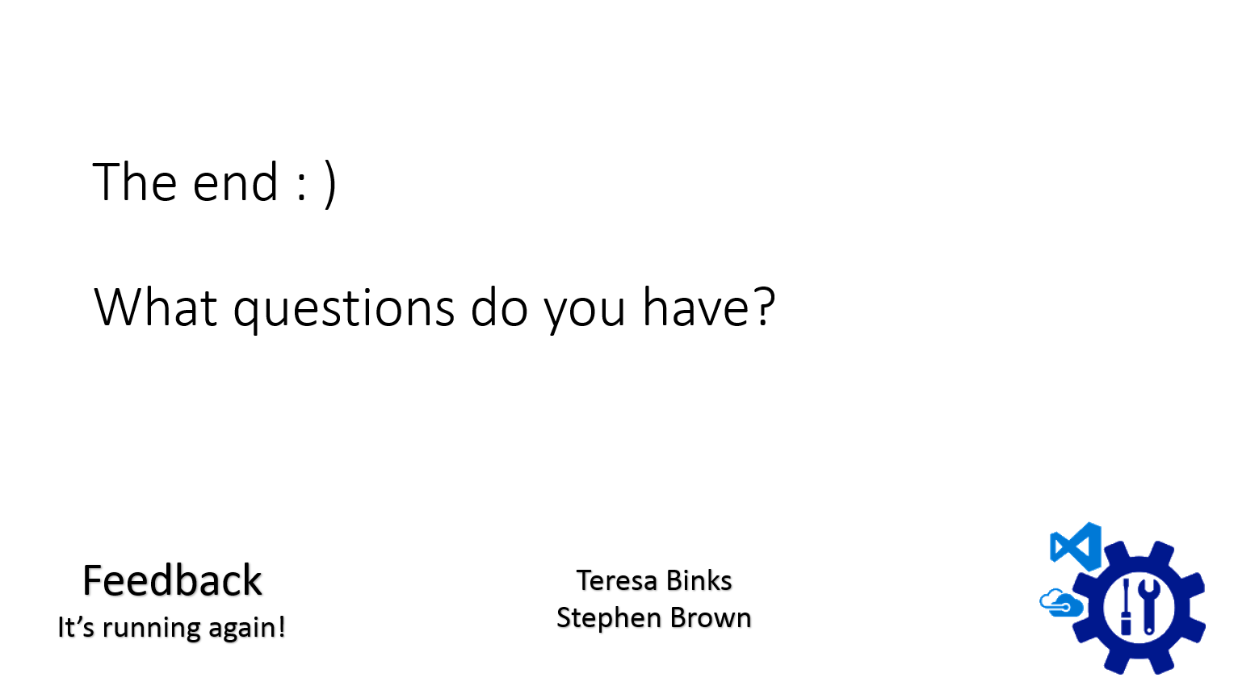
What it’s about
What it’s not about
Build-a-Cloud
So what?

Slide 3
Change
repeatability
supportability
extensibility
accessibility
- self service
DevOps
Whole Life Support
maturity
elevate state
Principles
Recoverability not Reliability
Cloud
Vs
On-Prem
Azure
Scaling and Performance

Slide 4

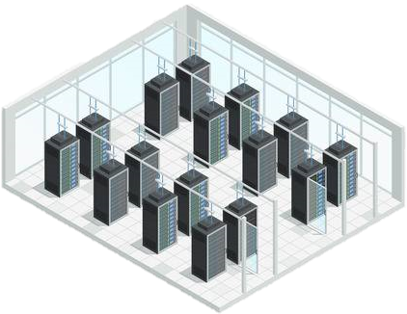
The Cloud

Slide 5
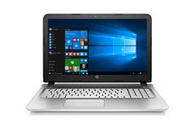
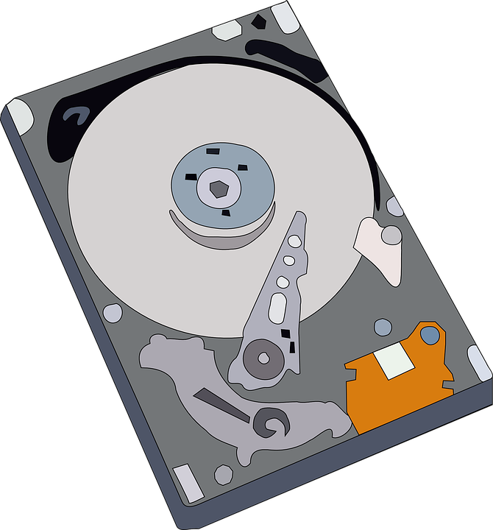
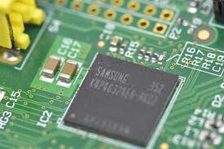





Slide 6
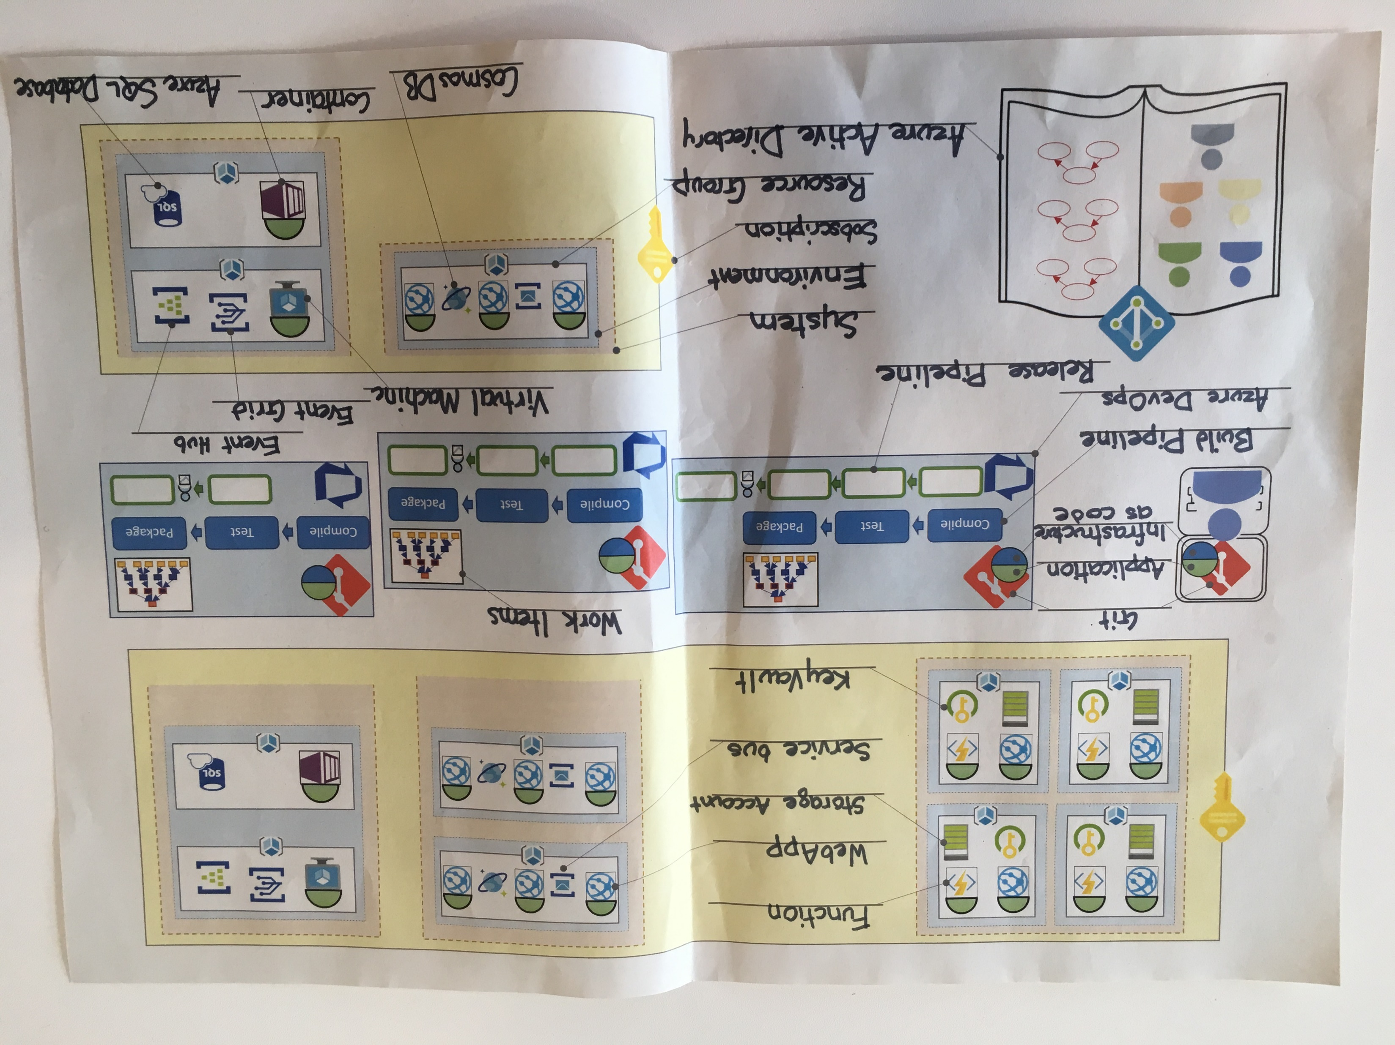

Slide 7
OMG we sold something!
As a
Local Authority
I want
a list of Residential Buildings in an area
So That
I can use that data to make plans

Slide 8
Geographic area in
List of residential buildings out
Interaction and Display on a webpage

Slide 9

☑ Approvals
☑ Business Case
☑ Management Sign off
☑ Budget
☑ Sufficient Coffee
☑ Cost Codes
☑ Investment Requests
☑ Training Requirements
☑ Developer Cake
☑ Development Space
☑ Architecture Review Board
Alex
Name your developer - Place your laptop

Slide 10
Developer
Laptop
Application
Application
Application
Place application on laptop

Slide 11

Developer
Laptop
Application
Version Control
Experimental changes.
Need to spike.
Need to safely trash changes.
Version Control (Git)
Place application on Git on laptop

Slide 12

Developer
Laptop
Application
Version Control
Subscription
Need to deploy to Azure
Subscription
Add subscription – Name it a breakfast food

Slide 13

Developer
Laptop
Application
Version Control
Subscription
ARM
Need Authorisation
Azure Resource Manager
The ARM

Slide 14

Developer
Laptop
Application
Version Control
Subscription
ARM
Need Authorisation
… has the role of…
… on the resource called…
Alex
Contributor
eggs
Role Based Access Control
RBAC
in the
Azure Resource Manager
The ARM
Give your developer access to your subscription via the ARM

Slide 15

Developer
Laptop
Application
Version Control
Subscription
ARM
Need “Who”
Need Authentication
Azure Active Directory

Slide 16
Users
Alex
Azure Active Directory
Groups
Group Name:
Users:
Group Name:
Users:
Add your developer to AAD

Slide 17








Slide 18

Developer
Laptop
Application
Version Control
Subscription
ARM
AAD
Resource Group
Need to deploy to Azure
Resource Group
Add Resource Group to Subscription

Slide 19



Developer
Laptop
Application
Version Control
Subscription
AAD – user and permission
Resource Group
Execution Environments
Application
WebApp
Add WebApp to Resource Group – run a copy of the application on it

Slide 20
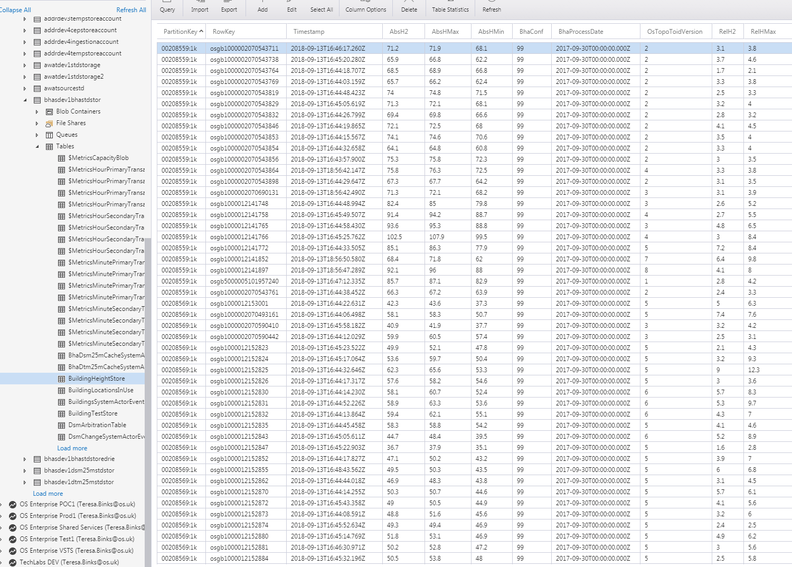
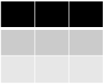
Developer
Laptop
Application
Version Control
Subscription
AAD – user and permission
Resource Group
WebApp + Application
Table Storage+ Storage Account
Need real data
Table
Table Storage

Slide 21

Developer
Laptop
Application
Version Control
Subscription
AAD – user and permission
Resource Group
WebApp + Application
Table Storage+ Storage Account
Need real data
Storage Account
Table
Storage Account >
Table Storage
Add Storage account to Resource Group – label the fact we’re using table storage

Slide 22
Developer
Laptop
Application
Version Control
Subscription
AAD – user and permission
Resource Group
WebApp + Application
Table Storage+ Storage Account
Connection String
Need to connect
Storage Account
// stg1ad4g7
Table

Slide 23
Developer
Laptop
Application
Version Control
Subscription
AAD – user and permission
Resource Group
WebApp + Application
Table Storage+ Storage Account
Connection String
Need to connect
Storage Account
// stg1ad4g7
Table

Slide 24

Developer
Laptop
Application
Version Control
Subscription
AAD – user and permission
Resource Group
WebApp + Application
Table Storage+ Storage Account
Need to connect
securely
Storage Account
// stg1ad4g7
// stg1ad4g7
Table
Key Vault
Add KeyVault – put Storage Account’s connection string in KeyVault

Slide 25


Slide 26
They want more
As a
Local Authority
I want
a list of heighted Residential Buildings in an area
So That
I can use that data to make plans

Slide 27
Query the building heights data source
For every building
Simple Application
+ Execution Environment
This feels like a lot of work – we need more developers!

Slide 28

Roby
Name your new Developer – give them access to the subscription in AAD

Slide 29

Need to collaborate
on code
on work
Azure DevOps
Add Git to Azure DevOps – Add application to Azure DevOps’ Git
Add Git to Developer 2’s laptop – Add application to Developer 2’s Git

Slide 30
Application
Push
Pull
Application
Application

Slide 31
Application
Pull
Push
Application
Application

Slide 32
Developer
Laptop
Application
Version Control
Subscription
AAD – user and permission
Resource Group
WebApp + Application
Table Storage+ Storage Account
2nd Developer+ git, application
Azure DevOps
Need to collaborate
effectively

Slide 33
Developer
Laptop
Application
Version Control
Subscription
AAD – user and permission
Resource Group
WebApp + Application
Table Storage+ Storage Account
2nd Developer+ git, application
Azure DevOps
Environments x2
Need to collaborate
effectively
alx1
in isolation
rby1
4 characters
Environments
Add a second environment – Give both environments a 4 character name, related to the developers

Slide 35
Developer
Laptop
Application
Version Control
Subscription
AAD – user and permission
Resource Group
WebApp + Application
Table Storage+ Storage Account
2nd Developer+ git, application
Azure DevOps
Environments x2
Environments +2
Need to collaborate
effectively
dev1
dev2
integrated
ci01
with stakeholders
prod
Environments
Add two more environments – call them ci01 and prod

Slide 37
Need Version Control on infrastructure
Application
WebApp Instances: 1
WebApp size: S1
Storage Account: 1
KeyVault: 1
Infrastructure as code
Add Infrastructure to Git for Developer1, to Azure DevOps, and to Developer 2. Fill in Infrastructure values on each one.

Slide 38


Need Repeatability
Compile
Test
Package
Deploy to:
Deploy to:
Deploy to:
Application
ci01
prod
alx1
WebApp : 1
Storage-Account: 1
KeyVault: 1
Deploy to:
rby1
Add Build Pipeline and Release Pipeline to Azure DevOps. Fill in environments in the release
Pipelines

Slide 39
We did all this because we added a developer to our team.
Let’s revisit our product requirements:

Slide 40
As a
Local Authority
I want
a list of heighted Residential Buildings in an area
So That
I can use that data to make plans

Slide 41
Query the building heights data source
For every building
Simple Application
+ Execution Environment

Slide 42
First, we need a height source
Height is a separate product portfolio, with its own product team (Da Vinci)
Add the Height AzureDevOps Team Project.
Add an environment for BHA and name it “prod”.
Add a resource group for the resources
Add the BHA service

Slide 43
Need clear separation of responsibilities
4 characters
System
Add the BHA system (bhas).
Add your system, and name it.

Slide 44


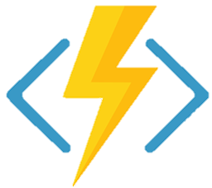
?
?
?
?

Slide 45
Query the building heights data source
For every building
Simple Application
+ Execution Environment

Slide 46
Developer
Laptop
Application
Version Control
Subscription
AAD – user and permission
Resource Group
WebApp + Application
Table Storage+ Storage Account
2nd Developer+ git, application
Azure DevOps
Environments x2
Environments + 4
Pipelines
Functions
Need to have massive, simple scalability
Application
Function
Add “Function” :”1” to you infrastructure as code.
That infrastructure gets deployed by your pipeline to each environment, so add a function to each of your environments.

Slide 47

Developer
Laptop
Application
Version Control
Subscription
AAD – user and permission
Resource Group
WebApp + Application
Table Storage+ Storage Account
2nd Developer+ git, application
Azure DevOps
Environments x2
Environments + 4
Pipelines
Functions
Need to send messages
Storage Account
Queue

Slide 48


So now we have a system that gives heights of residential buildings
Storage Account
Application
Table
Application
?
Building Heights System
Queue
Queue
WebApp

Slide 49
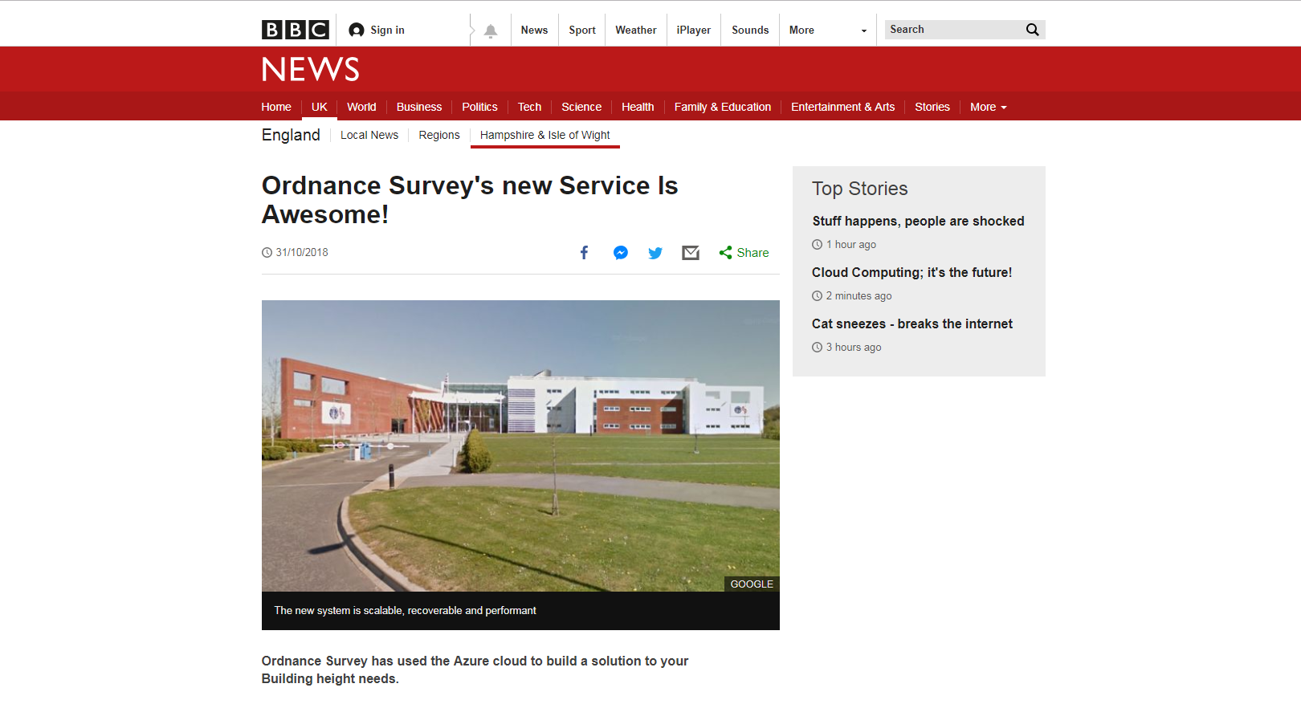

Slide 50
Our site is being hammered!
We need more capacity!
Panic!!!!!
“WebApp size: B3”
“WebApp size: S1”
Infrastructure
Change the WebApp size on your infrastructure as code.
Attach a bigger WebApp instance to the back of the WebApps in each environment
Contrast to now…..
Self-Provisioning

Slide 51
They want even more
As a
Local Authority
I want
a list of heighted Residential Buildings in an area
the population density of Residential Buildings in an area
So That
I can use that data to make plans

Slide 52
Office for National Statistics
Compressed file
Once a quarter
Somewhere to load
Something to unpack
(application and execution environment)
Somewhere to store

Slide 53

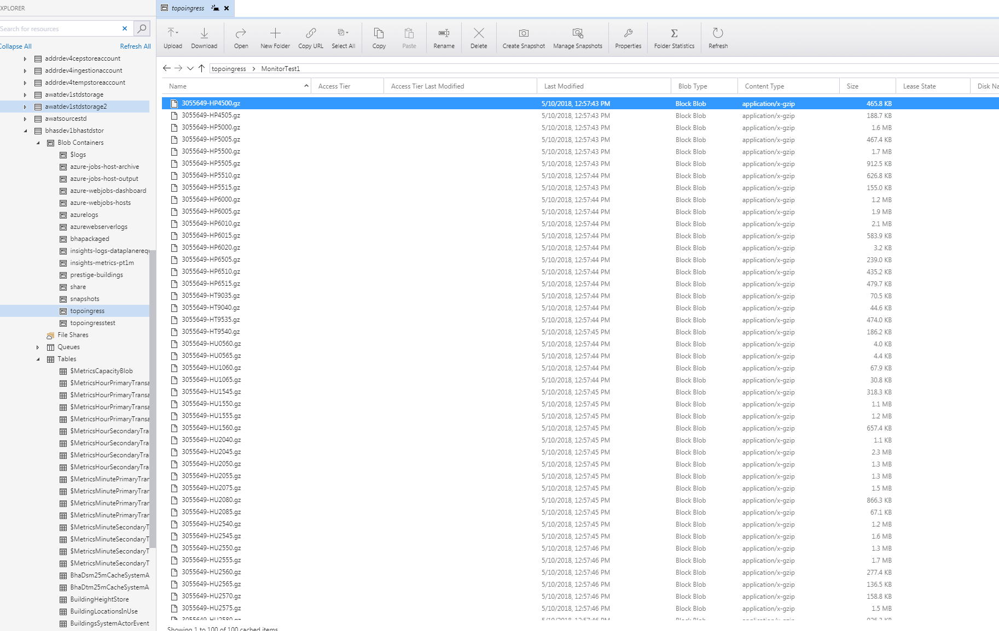
Need somewhere to load
Blob
Blob Storage

Slide 54
Need to unpack data
Application
Application
Execution Environment

Slide 55

Need to notice the file load
Event Grid

Slide 56
Need somewhere to store
Table
Blob
Storage account

Slide 57
Done!
But…..
It’s too slow…

Slide 58

Need more performance from storage
Table
Blob
Cosmos DB
Storage account

Slide 59
Breaking News!!!!! Again! OS’ new service is even more awesome!
Our site is being hammered!
We need more capacity!
Panic!!!!!
“WebApp size: B3”
“#Instances: 3”
“#Instances: 1”
Infrastructure
Contrast to now…..

Slide 60
Done!
What have we missed?

Slide 61
Storage things
Things that hold data

Slide 62

Storage Account
// stg1ad4g7
Table
Queue
Blob
File
File storage

Slide 63



Azure SQL

Slide 64

Data Lake

Slide 65
Execution Environments
Application
Things that run code

Slide 66


Virtual Machines

Slide 67
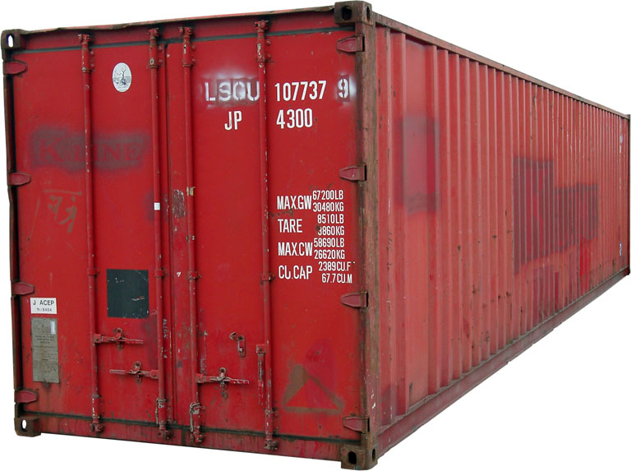
Containers

Slide 68
Messaging things
Things that pass messages

Slide 69

Service Bus
Queue Storage’s big brother

Slide 70

Event Hub

Slide 71
What’s my takeaway?
What is and isn’t Azure
What is my tech lead going on about with subscriptions and queues?
What’s the impact on me?

Slide 72

Your developers need you!
Time and space
Learn the new
Fear
Temptation to fall back to the traditional mindset
Particularly with project pressures
Application
Infrastructure
DevOps, infrastructure, support
are not job roles for individuals in your teams
they are team responsibilities, culture and practices.
Insist on it

Slide 73
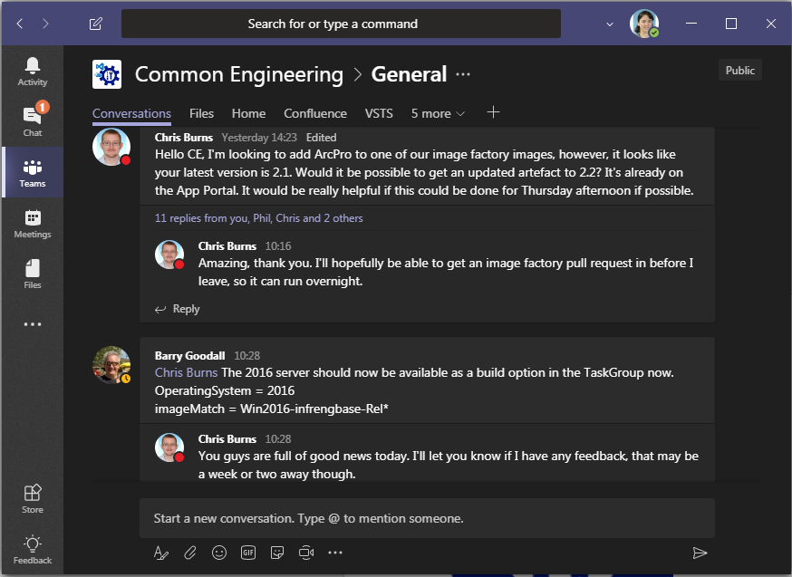

Common Engineering

Slide 75
The end : ) What questions do you have?
Feedback
It’s running again!
Teresa Binks
Stephen Brown
Tom Prutz

